Slide 1

NAAC Accredited & ISO 9001:2015 Certified Institute
V.V.P INSTITUTE OF ENGINEERING & TECHNOLOGY, SOLAPUR
(Approved by AICTE, DTE, Mumbai & Affiliated to DBATU, Lonare)
Seminar
“A VIRTUAL KEYBOARD IMPLEMENTATION BASED ON FINGER RECOGANIZATION”
Under the Guidance of
Prof. P.S. Pasnur
Soham Birajdar
Riddhesh Padma
Akash Sankanna
Rohan Mushan

Slide 2
A VIRTUAL KEYBOARD IMPLEMENTATION BASED ON FINGER RECOGANIZATION

Slide 3
Contents
Introduction
4
Object of Project
5
Concept of our Project
6
Methodology used
7
Project workflow
8

Slide 4
Technical Specification
9
Project Output
10
Application
11
Future updates
12

Slide 5
Introduction
3
Image processing is a branch of signal processing that can correspond to input and output images or video tapes as images or their various parameters. Gesture recognition and colorization is an image processing process.
Recently, many gesture recognition methods have been proposed. Hand tracking has a variety of operations, including motion capture, human-computer interaction, and human behavior analysis. Different types of detectors and tracking gloves areused for detecting and tracking hand movements.
Instead of using more expensive sensors, simple webcams recognize gestures and track movements. Videoconferencing is all the rage right now. For this reason, most computer users use webcams on their computers, and most laptops have built-in webcams

Slide 6
Objective of Project
They suggested an I-Keyboard with DND. For the first time, I-Keyboard aimed to create a fully functional keyboard that does not require any changes.
Users may begin typing from wherever on the touch screen without having to worry about the form or position of the keyboard.
The purpose is to operate keyboard without the physical touch to keyboard.

Slide 7
Concept of Project
Data Collection:
The dataset for this project contains all the alphabets, numbers, symbols, of keyboard.
The dataset is consist of images for keyboard.
It recoganizes hand using K-NN Algorithum.

Slide 8
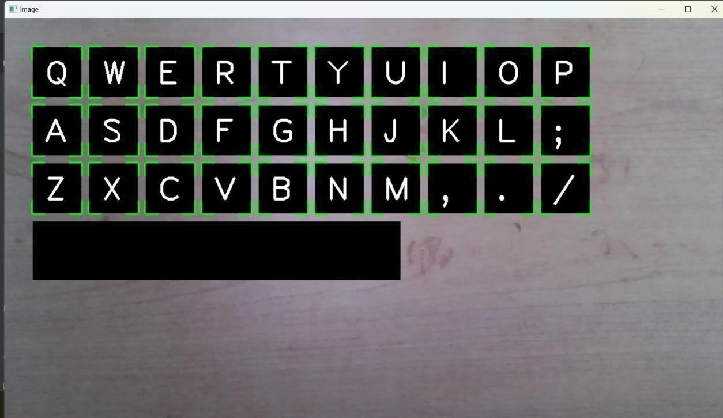
Keyboard Design
The Keyboard is QWERTY type.

Slide 9
Data preparation
To make the model predict accurate results we first
perform some operations on our coding.
Importing the required libraries.
Training our code and making a model so that we get
an accurate result.

Slide 10
Methodology used
k-NN Algorithm:
k-nearest neighbors algorithm ( k -NN for short) is a non-parametric machine learning method that is widely used for pattern recognition, data mining, signal processing and regression
In k -NN classification, k is a positive value that means the k closest training examples were selected to train the sample set. The core concept of k-NN algorithm is one of the simplest machine learning algorithms that can be used directly to classify the unknown data.
An artificial neuron:
An both artificial and biological networks, when neurons process the input they receive, they decide whether the output should be passed on to the next layer as input. The decision of whether or not to send information on is called bias and it’s determined by an activation function built into the system.

Slide 11
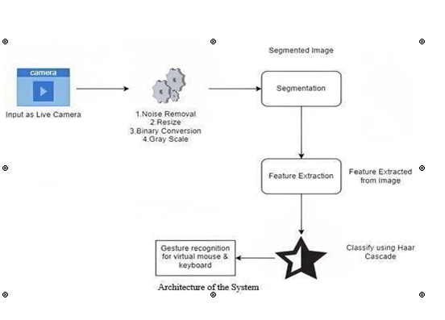
Project Workflow

Slide 12
Technical Specifications
Hardware requirements specification
PROCESSOR : Dell ,i3-i5
RAM : 1 GB
HARD DISK : 80GB
A Camera
Software requirement specification
Operating system : Dell ,i3-i5
Pycharm : Python
Client OS : Microsoft Windows 10/11
Front-end : Python
Back-end : Python
Database : Python

Slide 13
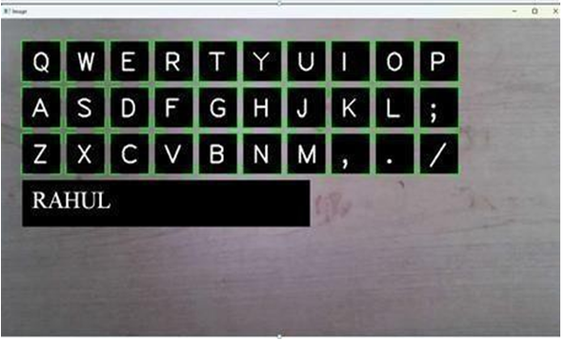
Project output

Slide 14
Applications
Accessibility
A virtual keyboard based on finger recognition can provide an alternative input method for individuals who have difficulty using traditional physical keyboards, such as those with motor impairments.
Convenience
A virtual keyboard can be used on a variety of devices, such as smartphones, tablets, and laptops, without the need for an external keyboard.
Hygiene
In public spaces, a virtual keyboard can reduce the risk of spreading germs as there is no physical contact with the keyboard.
Finger recognition technology can be used as a security feature to authenticate the user and prevent unauthorized access.
Security

Slide 15
Future updates
The system is completely autonomous. One of the finest characteristics is how simple it is to use. Future work will concentrate on algorithm optimization by combining the models developed and creating a whole virtual system handler that can manage the volume, brightness, and other functions as well as a virtual mouse and keyboard.
There is also a button that changes the keyboard characters to special characters so that they may be utilized as needed. With airport kiosk check-in devices, the virtual keyboard and mouse may be used combined for a touchless check-in experience.

Slide 16
References
Abu-Mostafa, Y. S. (1990). Learning from hints in neural networks. Journal of complexity, 6(2), 192-198.
Adachi, T., Furuya, R., Greene, S., & Mikuriya, K. (1991). Feature selection for neural network recognition. In IEEE International Joint Conference on Neural Networks, pp. 696-701.

Slide 17
All power is within you; You can do anything and everything
- Swami Vivekananda
Thank You

